Slide 1


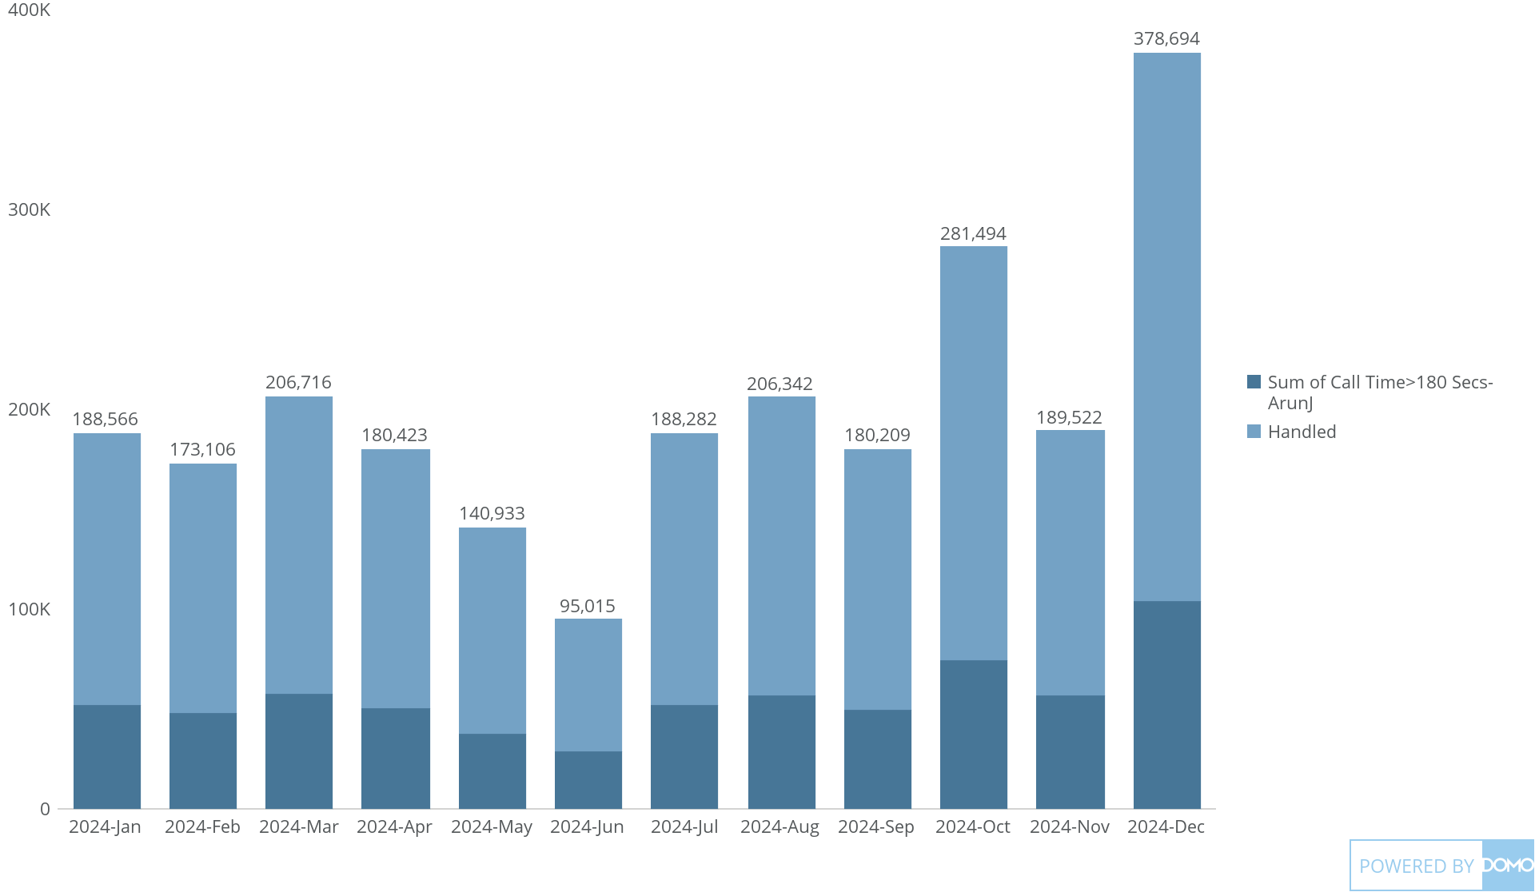
+
exported May 17, 2025, 12:29:00 PM UTC
PE 1 | CARD 1 | Calls > 180 Secs
Last Year, by Month

